Slide 1
Variable Mass BEM Analysis Summary
James Niffenegger
May 11, 2026

Slide 2
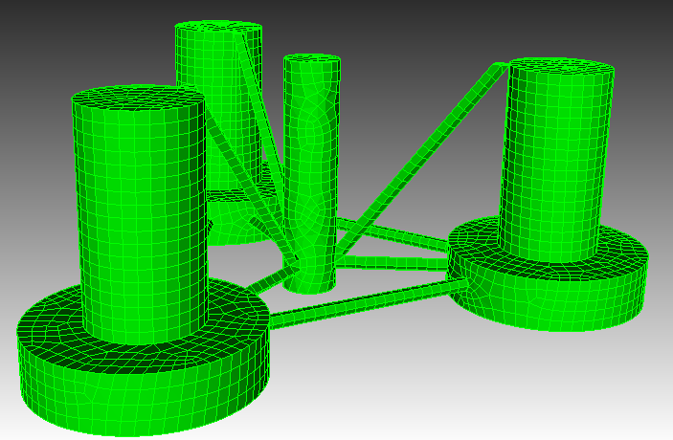
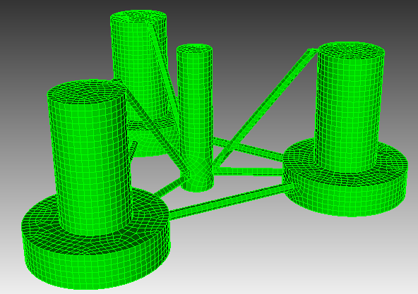
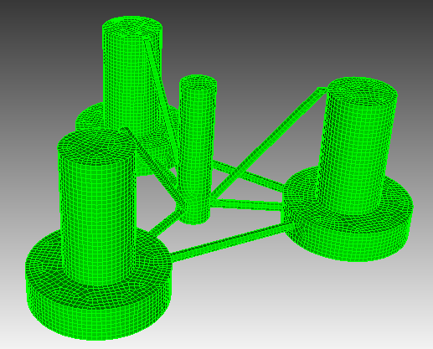
Mesh Sizes Considered
Mesh Size: 1.25
Mesh Size: 1
Mesh Size: 0.75
Meshes (.gdf files) made in Cubit of OC4 geometry with draft of 28 m
Uniform surface meshes with sizes listed above
Capytaine used to calculate hydrostatics and hydrodynamics for drafts between 18 and 22 m (in intervals of 0.4 m)
Capytaine also used to reduce draft of the meshes from 28 m

Slide 3
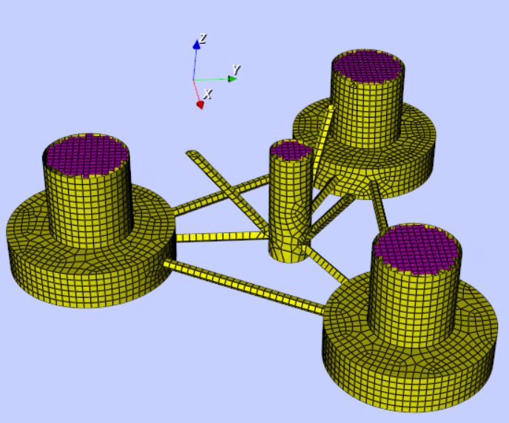
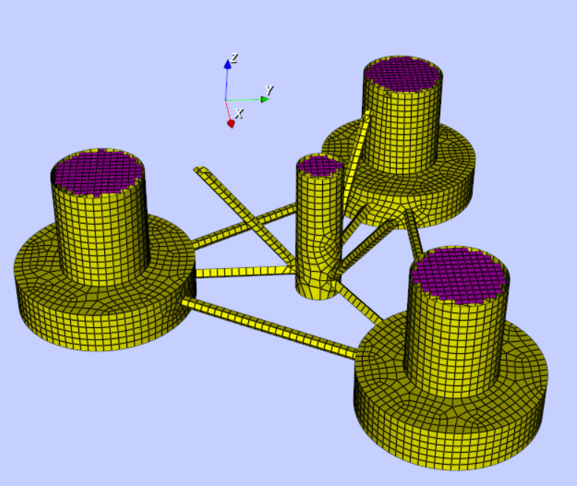
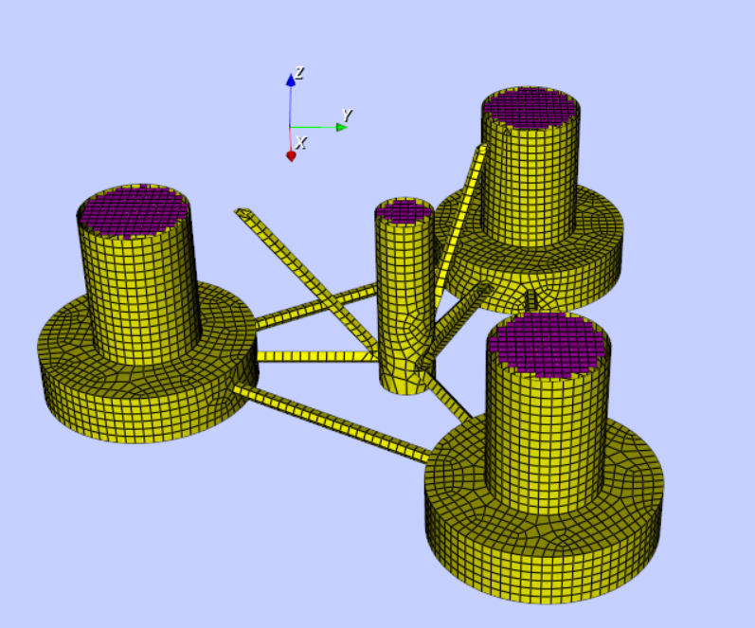
Capytaine Mesh Adjustments
Draft: 18 m
Draft: 20 m
Draft: 22 m
All meshes cut at waterline with lids added to them (purple)
All shifted 0.0001 above waterline to reduce error
Lid max face radius = 0.6

Slide 4
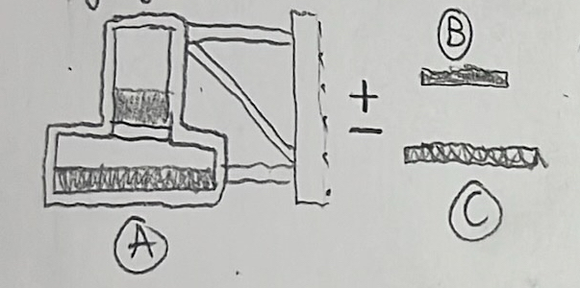
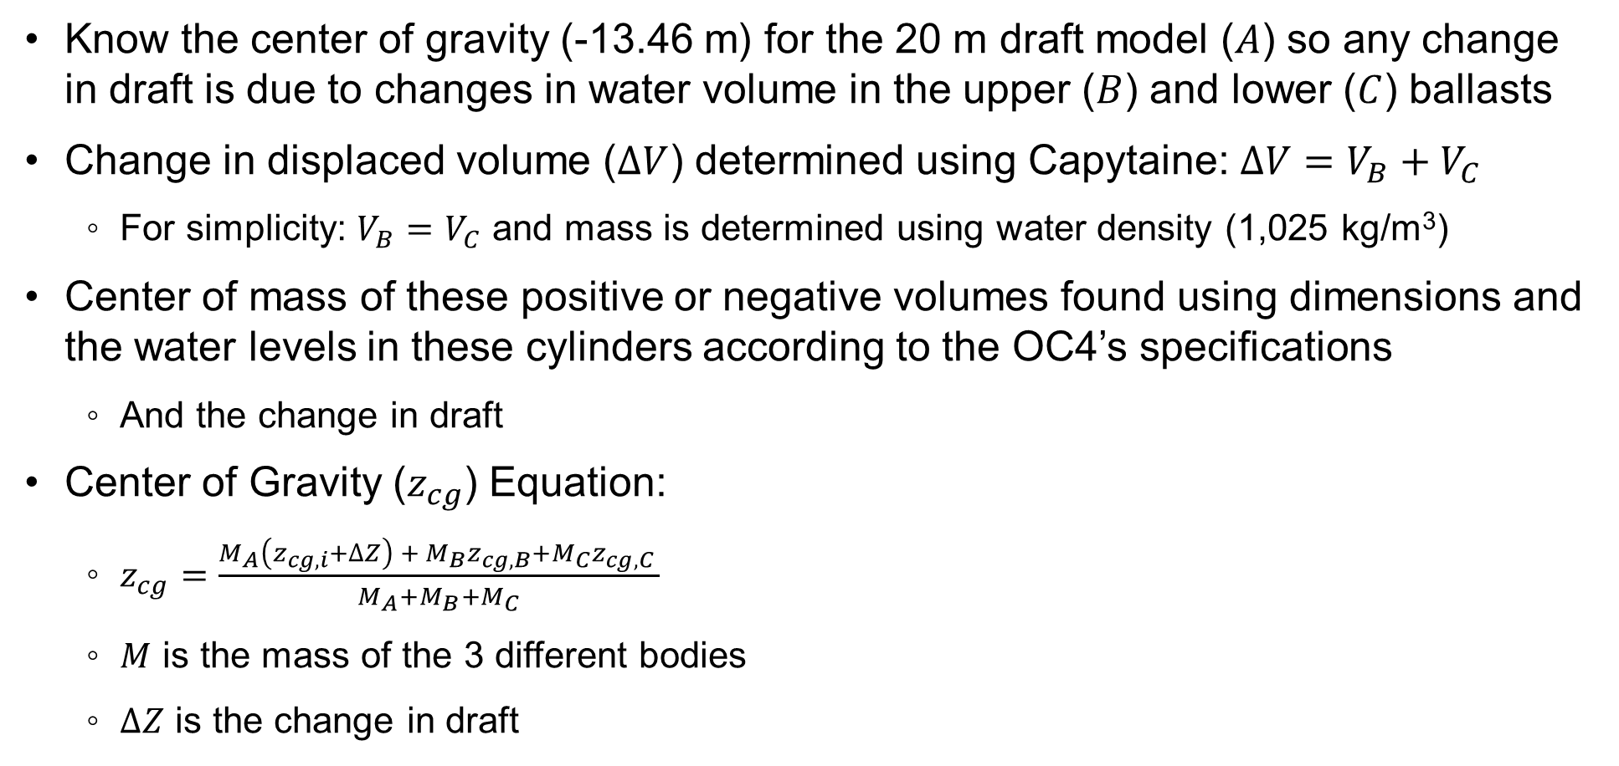
Center of Gravity Calculations
Know the center of gravity (-13.46 m) for the 20 m draft model ($A$) so any change in draft is due to changes in water volume in the upper ($B$) and lower ($C$) ballasts
Change in displaced volume ($∆V$) determined using Capytaine: $∆V=V_{B}+V_{C}$
For simplicity: $V_{B}=V_{C}$ and mass is determined using water density (1,025 kg/m³)
Center of mass of these positive or negative volumes found using dimensions and the water levels in these cylinders according to the OC4’s specifications
And the change in draft
Center of Gravity ($z_{cg}$) Equation:
$z_{cg}=\frac{M_{A}\left(z_{cg,i}+∆Z\right) + M_{B}z_{cg,B}+M_{C}z_{cg,C} }{M_{A}+M_{B}+M_{C}}$
$M$ is the mass of the 3 different bodies
$∆Z$ is the change in draft

Slide 5
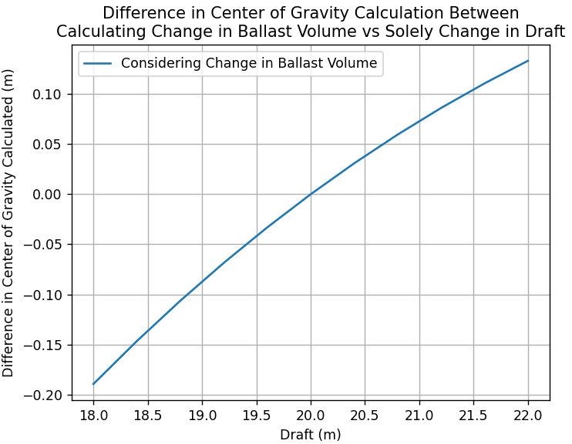
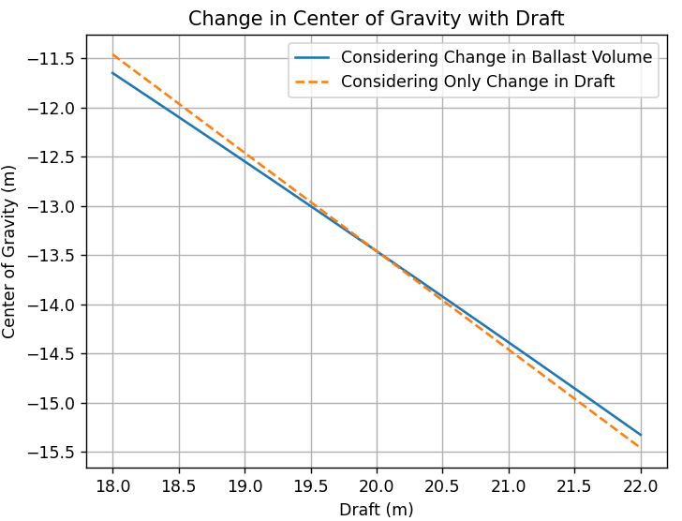
Change in Center of Gravity with Draft
Ballast mass of 20 m draft model verified with OC4 report (9.6 kt)
Mass of remaining structure is ~17% greater than the report (4.5 vs 3.9 kt) but verified in SolidWorks
Mass of the OC4 was calculated given the volume of the 20 m draft model & ballast mass
Change in ballast mass alters center of gravity by 10’s of cm vs draft alone

Slide 6
Added Mass at Infinity Comparison

Slide 7
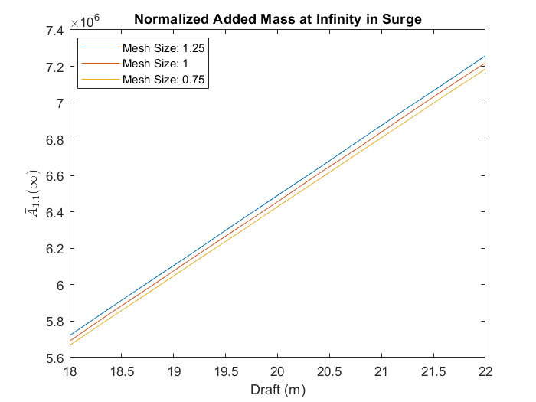
Added Mass at Infinity in Surge
Added mass (at infinity) in surge increases with increasing draft almost linearly
The added mass also decreases with decreasing mesh size

Slide 8
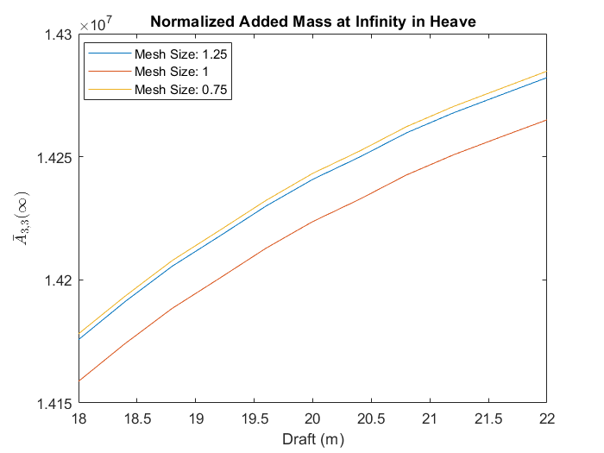
Added Mass at Infinity in Heave
Added mass (at infinity) in heave increases with draft
Added mass varies with mesh size
Lowest added mass occurs with medium mesh size
Highest added mass occurs with smallest mesh size

Slide 9
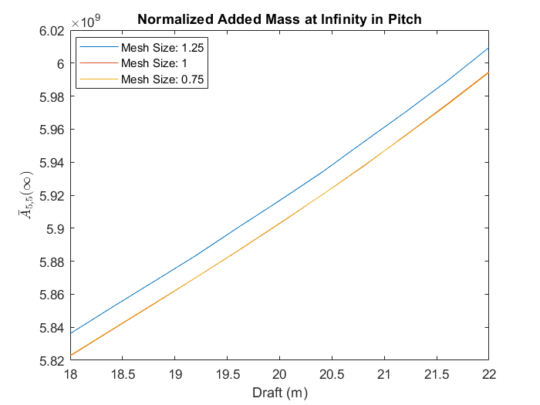
Added Mass at Infinity in Pitch
Added mass (at infinity) in heave increases with draft
Added mass nearly identical between mesh sizes of 0.75 and 1

Slide 10
Mesh Comparison for Added Mass & Radiation Damping
Results for one draft size (18 m) for simplicity

Slide 11
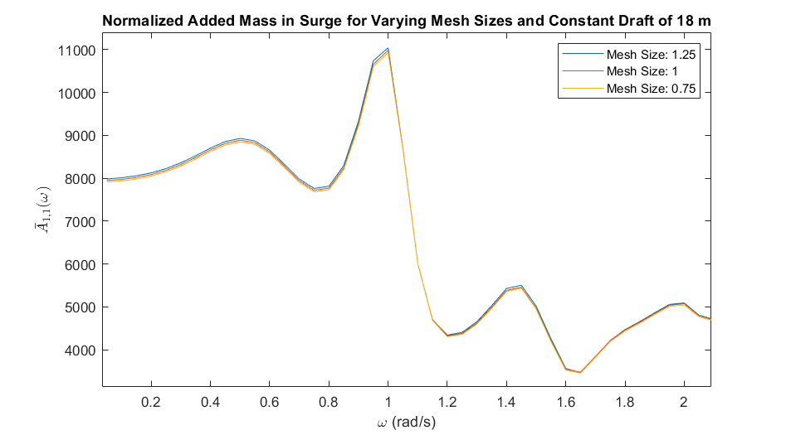
Added Mass in Surge
Results nearly identical between mesh sizes
Added mass decreases with decreasing mesh size

Slide 12
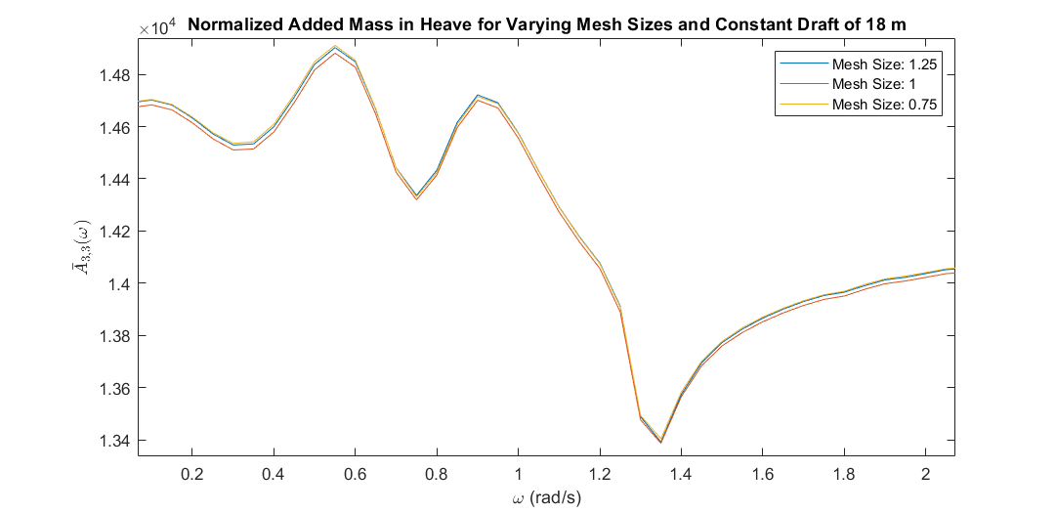
Added Mass in Heave
Added mass varies inconsistently with mesh size

Slide 13
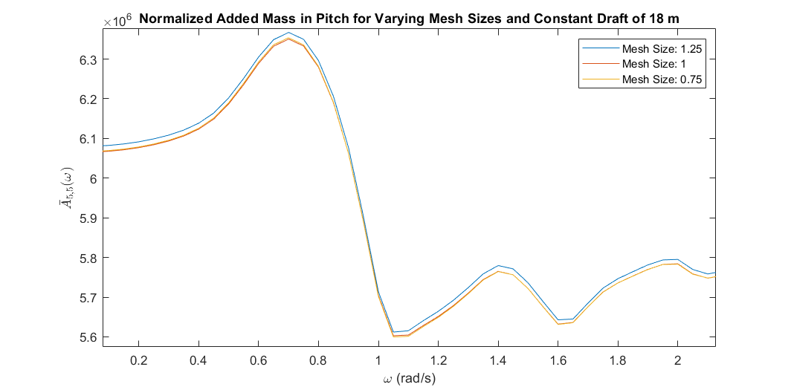
Added Mass in Pitch
Results nearly identical between mesh sizes 0.75 and 1

Slide 14
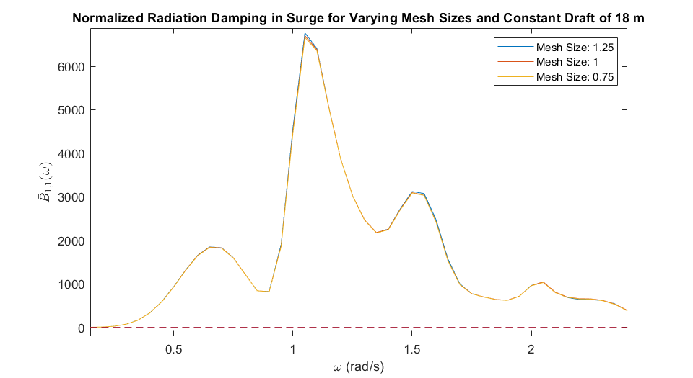
Radiation Damping in Surge
Results nearly identical between mesh sizes
Decrease with decreasing mesh size

Slide 15
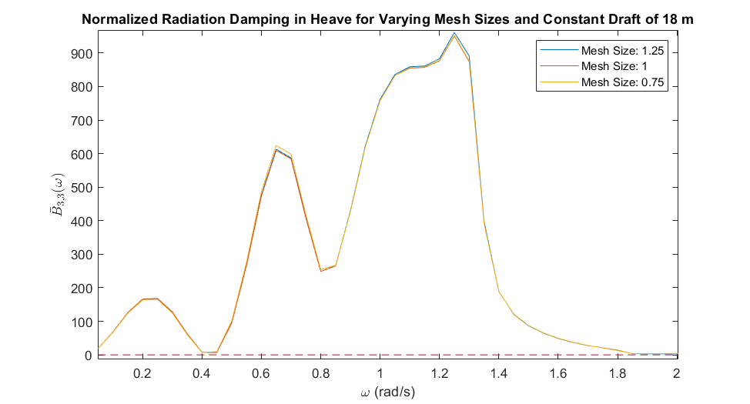
Radiation Damping in Heave
Results nearly identical between mesh sizes
Vary inconsistently with mesh size

Slide 16
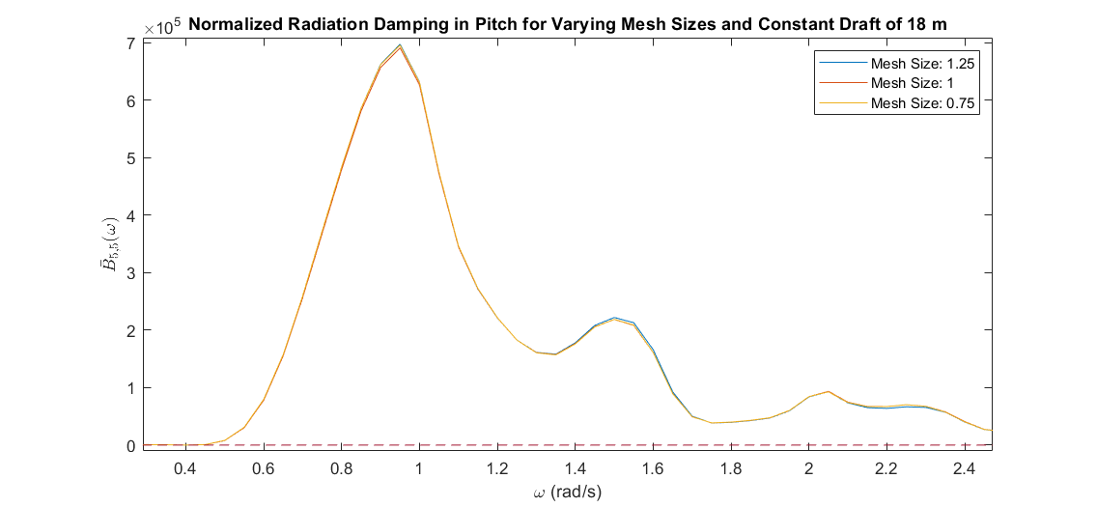
Radiation Damping in Pitch
Results nearly identical between mesh sizes
Vary inconsistently with mesh size

Slide 17
Draft Comparison for Added Mass & Radiation Damping
Results for one mesh size (0.75) for simplicity

Slide 18
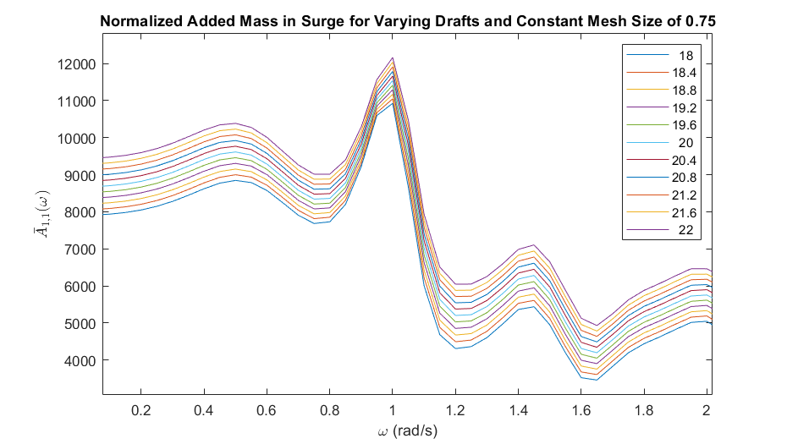
Added Mass in Surge
Added mass consistently increases with increasing draft at all frequencies

Slide 19
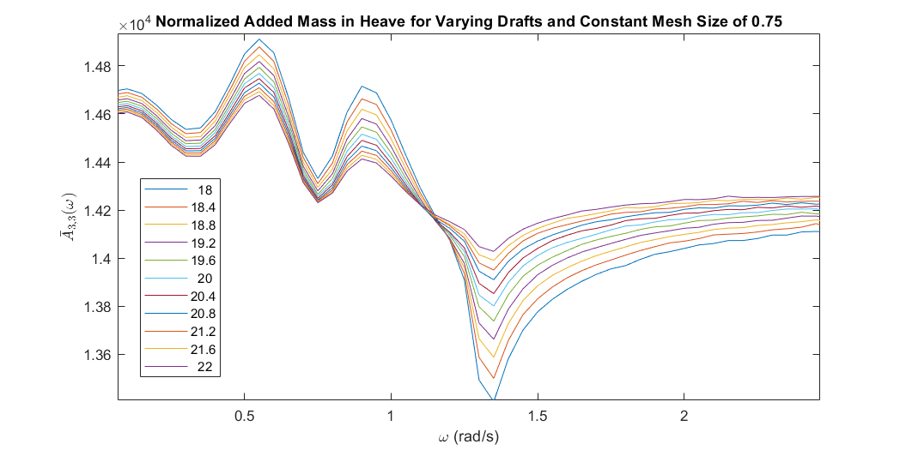
Added Mass in Heave
Added mass decreases with increasing draft at low frequencies (<1.15 rad/s)
Added mass increases with increasing draft above 1.15 rad/s

Slide 20
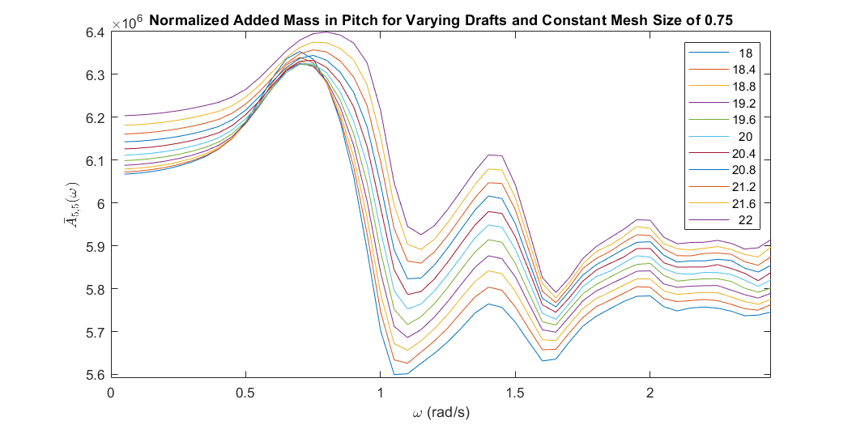
Added Mass in Pitch
Added mass mostly increases with increasing draft at all frequencies

Slide 21
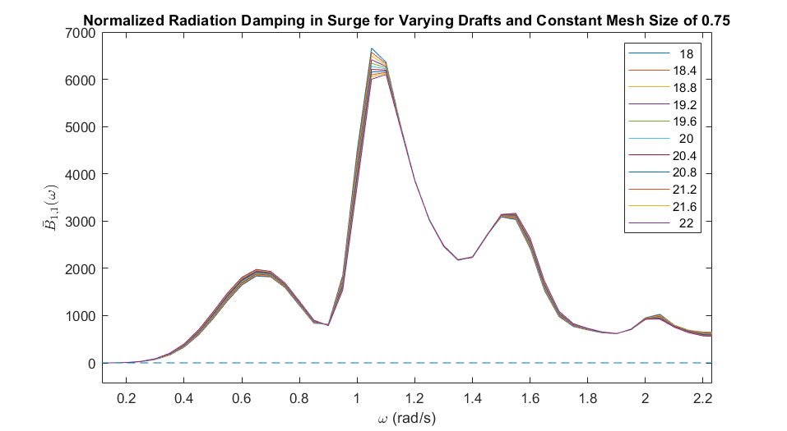
Radiation Damping in Surge
Results nearly identical
Radiation damping varies inconsistently with increasing draft

Slide 22
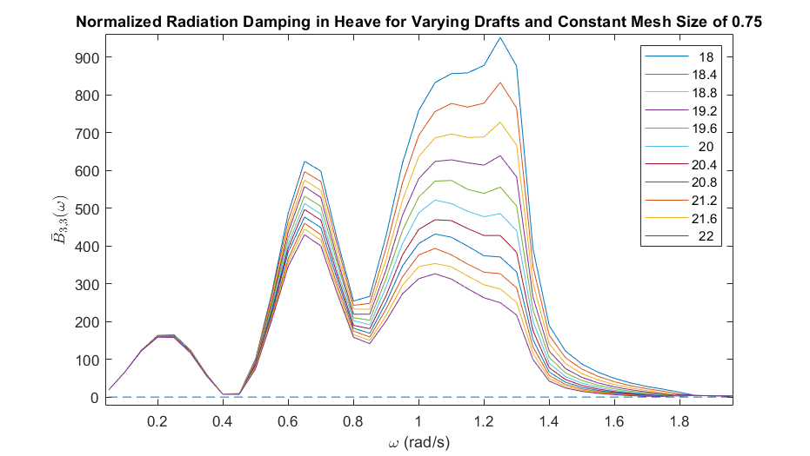
Radiation Damping in Heave
Radiation damping consistently increases with increasing draft at all frequencies

Slide 23
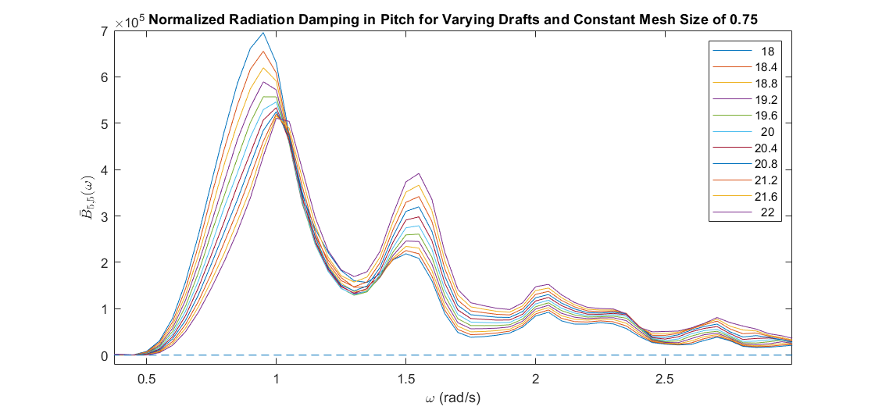
Radiation Damping in Pitch
Radiation damping decreases with increasing draft at frequencies below 1 rad/s
Radiation damping increases with increasing draft at higher frequencies

